Slide 1
MACHINE LEARNING PROJECT
Focusing on diabetes prediction
Qi Guo
Jayanth Reddy Bekkam
Khemraj Dahal
Parveen Kumari
Sri Ram Sai Kiran Cherukuri
Date: 2024-04-19

Slide 2
1
PART ONE
Introduction
Research background and significance

Slide 3

1.Introduction
Research background and significance
The burgeoning global diabetes epidemic poses a daunting challenge to healthcare systems worldwide. It is a condition characterized by chronic hyperglycemia with disturbances of carbohydrate, fat, and protein metabolism resulting from defects in insulin secretion, insulin action, or both. The long-term damage, dysfunction, and failure of various organs, especially the eyes, kidneys, nerves, heart, and blood vessels, make it a leading cause of morbidity and mortality globally. Our AI-driven application seeks to mitigate these challenges by offering a predictive and management tool for diabetes, harnessing the power of artificial intelligence (AI) to revolutionize healthcare practices and patient outcomes.

Slide 4
2
PART TWO
Data visualizations
Research objectives

Slide 5
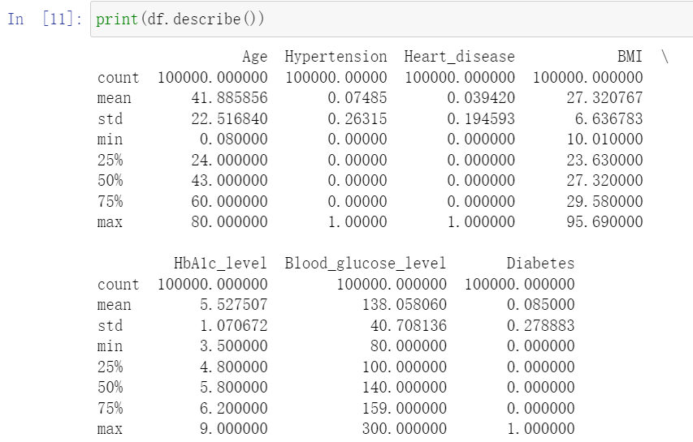
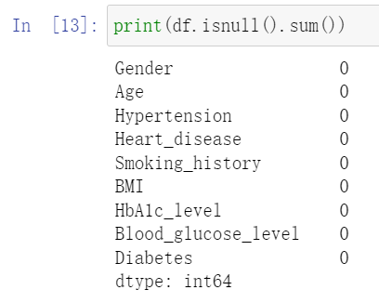
2.1 Descriptive Statistics

Slide 6
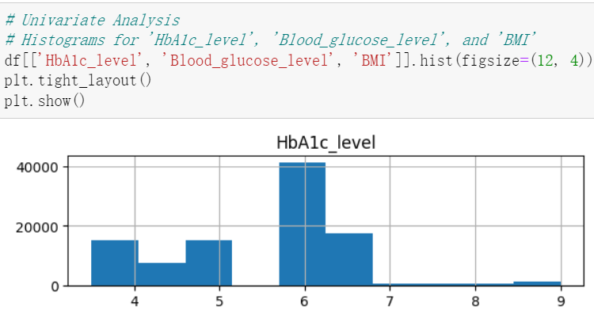
2.2 Data Visualisations

Slide 7
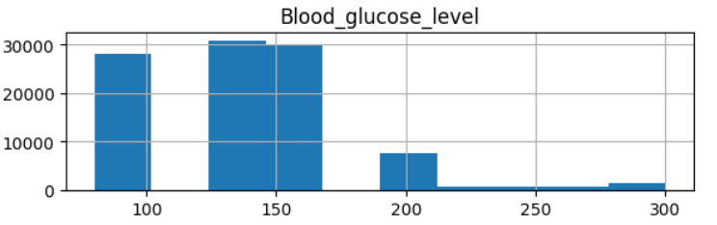
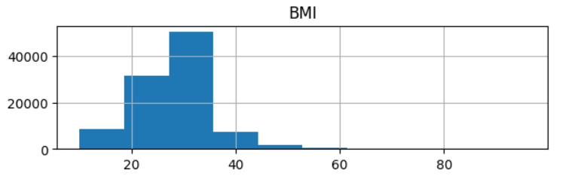
2.2 Data Visualisations

Slide 8
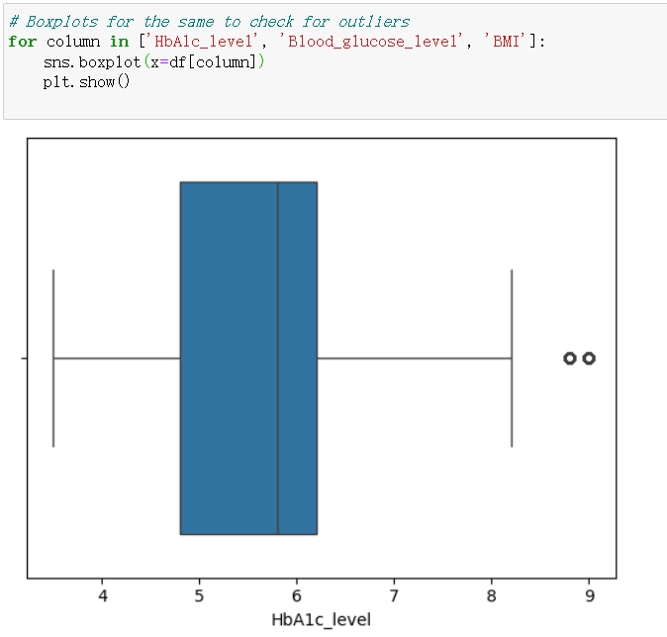
2.3 Boxplots for the same to check for outliers

Slide 9
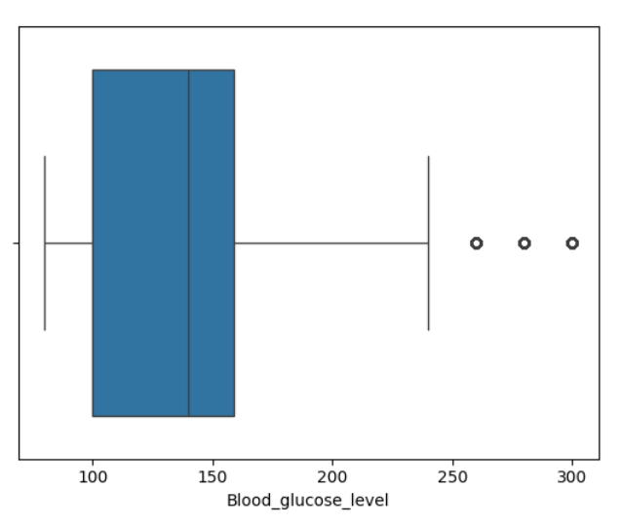
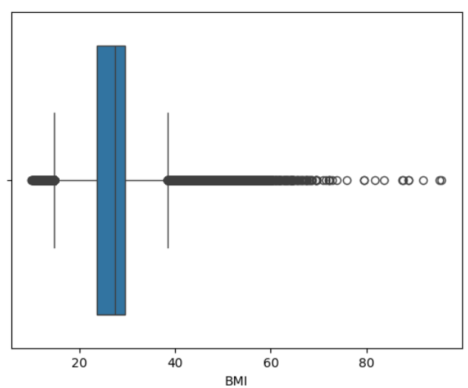
2.3 Boxplots for the same to check for outliers

Slide 10
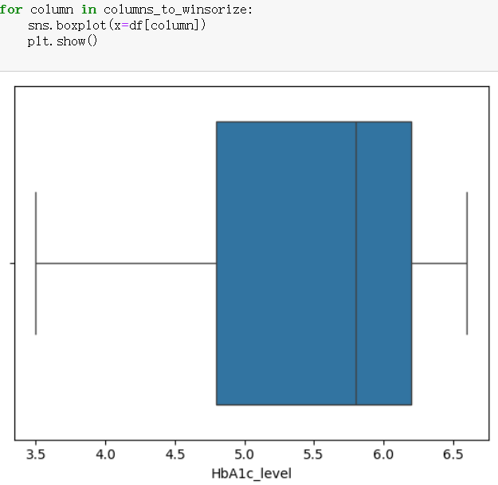
2.4 The effect of Winsorization

Slide 11
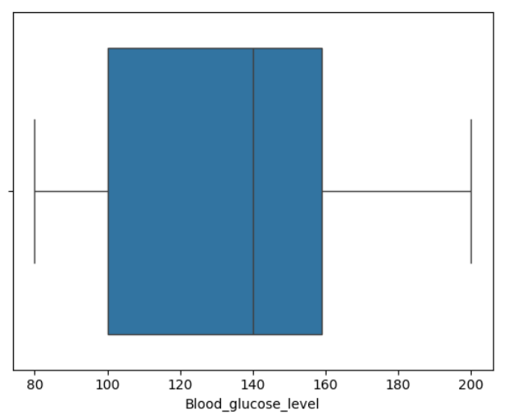
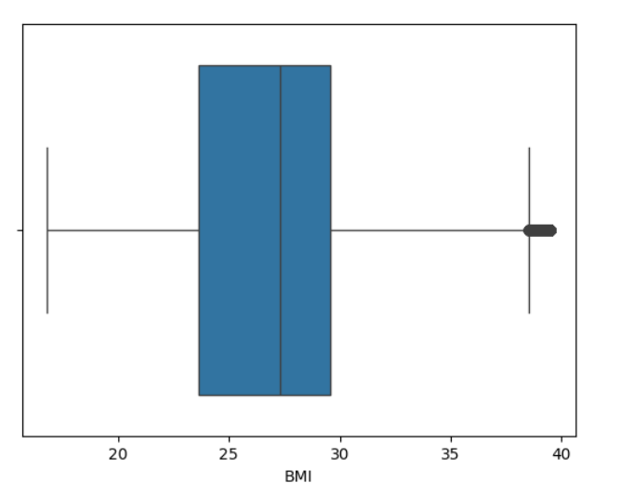
2.4 The effect of Winsorization

Slide 12
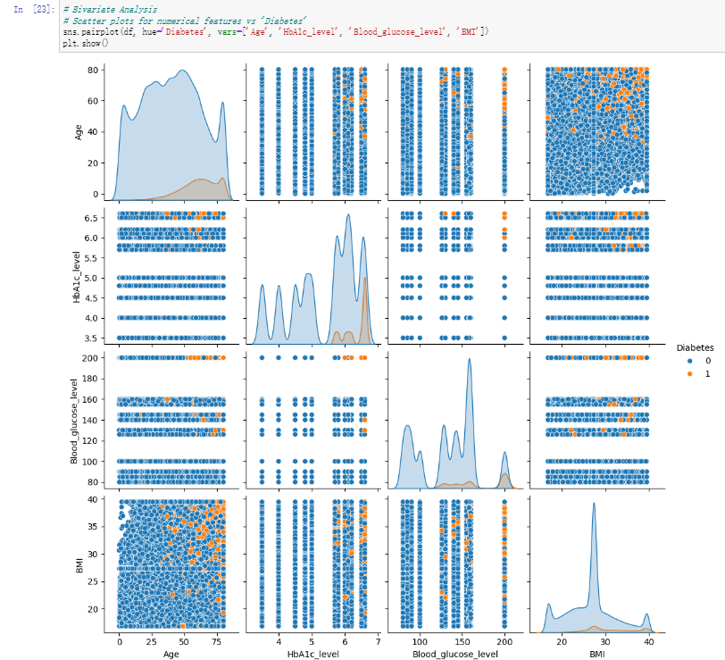
2.5 Bivariate Analysis

Slide 13
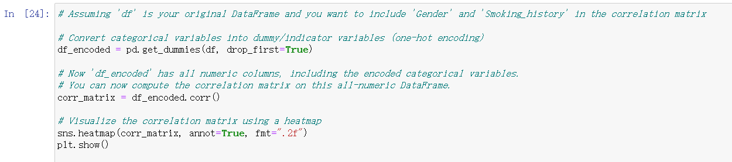
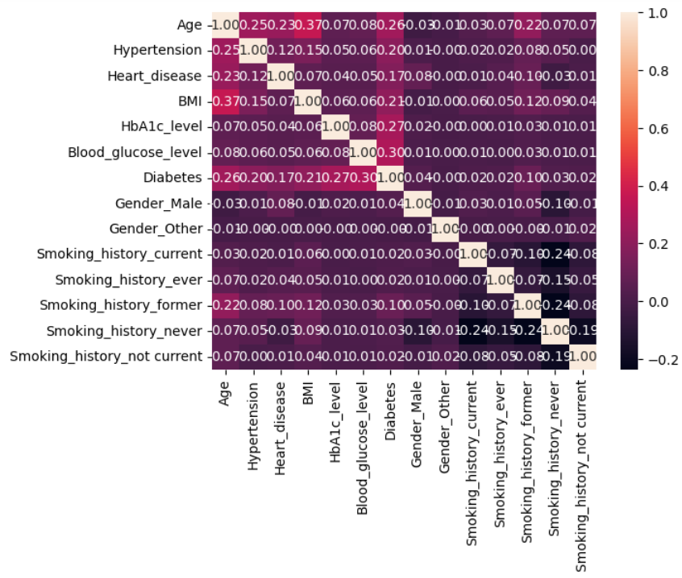
2.6 Visualize the correlation matrix using a heatmap

Slide 14
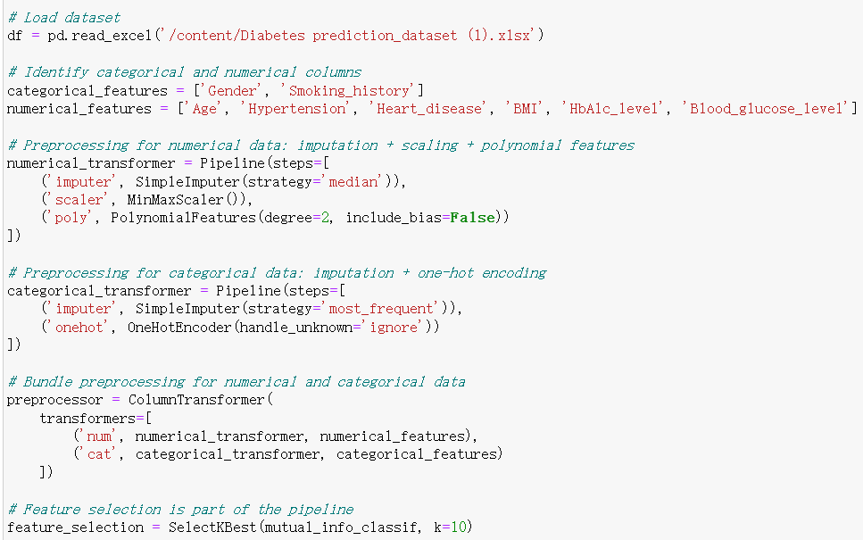
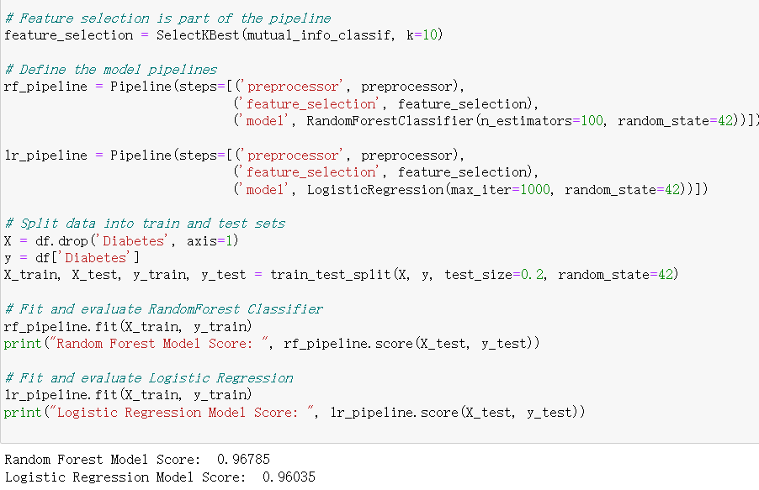

Slide 15
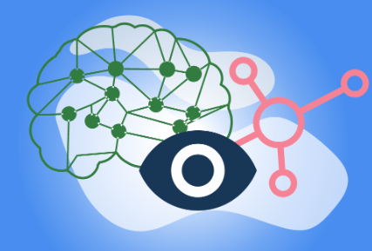
2.7 Conclusion
AI in diabetes care presents an exciting frontier with the potential to transform many aspects of healthcare delivery and patient outcomes. While the benefits are substantial, ranging from individualized care to improved systemic efficiencies, they come with a set of risks that are technical, ethical, and societal in nature. By acknowledging and preparing for these challenges, healthcare providers can harness the power of AI to deliver care that is not only more efficient and effective but also more equitable and human-centred.

Slide 16
3
PART THREE
Thanks
Machine Learning Final Project
Focusing on Diabetes Prediction

